Slide 1
Introduction to Node.js
Beginner’s Roadmap

Slide 2
Table of Contents:
What is Node.js?
Often used to build back-end services
What is so special about Node.js?
Why Node.js?
Node App
Other reasons for using Node.js
Node Architecture
JavaScript-Runtime environment
How Node.js works?
Installing Node.js

Slide 3
What is Node.js?

Slide 4
Node.js
Node or Node.js:
Is an open source and cross-platform runtime environment.
Is used to run javascript code outside of a browser.
Is used to build backend services, also called API’s or Application Programming Interfaces.
Is used to create services sitting on the server or in the cloud to store data, send emails, push notifications, and so on.

Slide 5
Often used to build back-end services
WEB APP
BACK-END SERVICE
MOBILE APP

Slide 6
What is so special about Node.js?
Highly scalable
Data intensive (process large volume of data)
Real-time
These above three points adds extra power to the backend services that are used by our client applications

Slide 7
Why Node.js?
It is easy to get started
Used for building a model of a system (Prototyping)
Used for agile development
Using Node.js we can build super fast back-end services
Node.js back-end services can be built faster with fewer people.

Slide 8
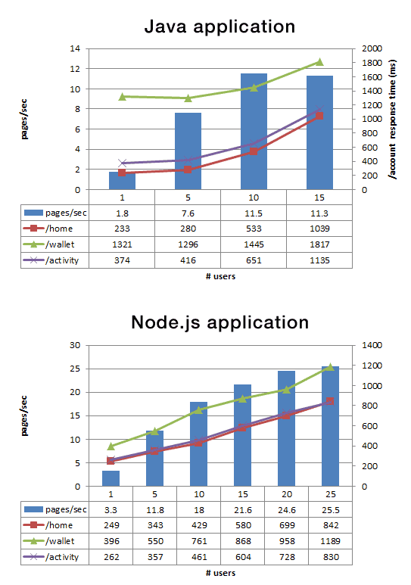
Node App
With fewer people - built fast
Less lines of code
Less files
Double the rate of request per second
35% faster response time
Notes:
recreation

Slide 9
Other reasons for using Node.js
JavaScript everywhere
Cleaner and more consistent codebase
Large ecosystem of open-source libraries

Slide 10
Node Architecture

Slide 11
Runtime environment
Earlier only JavaScript was used to build applications that will run inside the browser.
Every browser has their own JavaScript engine.
JavaScript Engine -
Converts our code into code that a computer can understand.
JavaScript code can give different output in different browser because each browser has their own engine.

Slide 12



Varieties of Engine
Chakra
SpiderMonkey
V8
GetaGaia, CC BY-SA 4.0 <https://creativecommons.org/licenses/by-sa/4.0>, via Wikimedia Commons
The Mozilla Foundation, CC BY 3.0 <https://creativecommons.org/licenses/by/3.0>, via Wikimedia Commons
Noémie2602, CC BY-SA 4.0 <https://creativecommons.org/licenses/by-sa/4.0>, via Wikimedia Commons

Slide 13
JavaScript – Runtime Environment
Node.js is a JavaScript runtime, uses a V8 engine.
JavaScript runtime has several components as follows,
Memory Heap
Execution/Call Stack
Web APIs Container
Callback Queue
Even Loop

Slide 14
JavaScript – Runtime Environment
Const walk = () => {
console.log(‘Walking!!’);
run ();
}
Const run = () => {
console.log(‘Running!!’);
run ();
}
Const run = () => {
console.log(‘Rest!!’);
run ();
}
walk();
O/P
Walking !!
Running !!
Rest !!
Drink water !!
Notes:
Self created

Slide 15
JavaScript – Runtime Environment
Execution/ Call Stack
API Container
Event loop
Callback Queue
Notes:
Self created

Slide 16
JavaScript – Runtime Environment
Execution/ Call Stack
API Container
rest ()
run()
setTimeout 2 seconds
walk()
Call
Event loop
Callback Queue
Notes:
Self created

Slide 17
JavaScript – Runtime Environment
Const walk = () => {
console.log(‘Walking!!’);
run ();
}
Const run = () => {
console.log(‘Running!!’);
run ();
}
Const run = () => {
console.log(‘Rest!!’);
run ();
}
walk();
Execution/ Call Stack
API Container
callback
rest ()
setTimeout
run()
walk()
O/P
Walking !!
Running !!
Rest !!
Drink water !!
Call
Event loop
Callback Queue

Slide 18
How Node.js works?

Slide 19
Model used by Node.js
Node uses an event-driven non-blocking I/O model.
Input/Output (I/O) model refers to,
Input/output operations
Reading/writing files
Making API calls
There are two types of I/O models,
Blocking I/O model
Non-blocking I/O model

Slide 20
I/o Model types
Blocking I/O model -
Subsequent code will be blocked from execution by the code comes before.
Code inside the execution stack is NOT executed simultaneously.
Non-Blocking I/O model -
Code will not be blocked from execution by the code comes before.
JavaScript follows non-blocking I/O model.

Slide 21
Installing Node

Slide 22
Environment setup: Windows
In the search bar, type Command Prompt. Click on the first search result to open.
Alternatively, press Win+R.
In the Run window that pops up, type cmd in the Open text field and click on OK.
Check if node.js is installed or not by typing ‘node –v’ command in Command Prompt.
Press Enter.

Slide 23
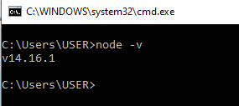
Environment setup: Windows
If you see any version, then Node.js is already installed on your machine.

Slide 24

Environment setup: Windows
If you get the below message then, we need to install node.js from this link ‘https://nodejs.org/en/download/’

Slide 25
Environment setup: MacOS
Press Cmd+Space to open Spotlight Search, and type Terminal.
Click on the first search result to open it.
Check node.js is installed or not by typing ‘node –v’ command in terminal.
Press Enter.

Slide 26

Environment setup: MacOS
If you see any version, then Node.js is already installed on your machine.

Slide 27

Environment setup: MacOS
If you get below message then, we need to install node.js from this link ‘https://nodejs.org/en/download/’.

Slide 28
Questions ?

Slide 29
Thank You!

